Slide 1
Сomputer safety
What are the security risks of USB drives?

Slide 2
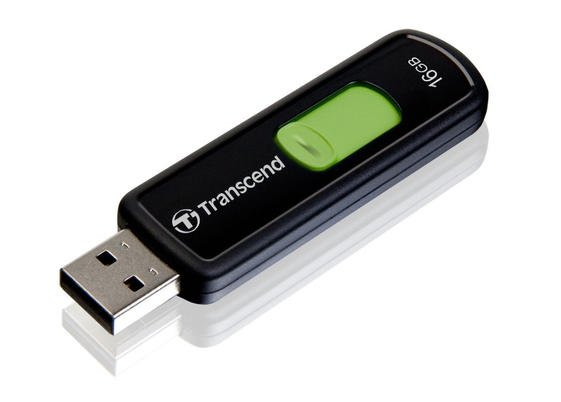
What Is a USB Flash Drive?
A USB flash drive is a storage device that combines flash memory with a built-in Universal Serial Bus (USB) interface. The majority of USB flash drives are rewritable and detachable. They are physically small, durable, and dependable. The more storage space they have, the faster they work.
Because there are no moving parts, USB flash drives are highly durable mechanically. The USB port on the device powers them they're connected to. A flash drive or USB drive is another name for a USB flash drive.

Slide 3
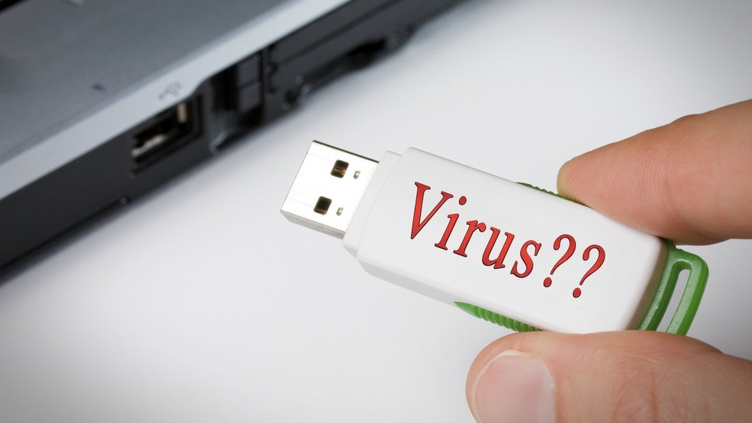
What is a USB attack?
This one is simple. A USB attack is pretty much any transmission of malicious software via a USB device. There are at least 29 different types of USB malware attacks capable of being carried out in many different ways. Here are the most common ones:
Through USB drives. A USB can accidentally download an infected file from someone’s laptop, then transfer it to yours. Or a USB drive can be purposefully infected, then either directly or indirectly handed to you. Like, dropped in a parking lot for you to find it (it’s called a USB drop attack and is more popular than you’d imagine).
Through USB ports in charging devices or stations. This is called juice-jacking, and there isn’t any information or guidance on how to protect a USB from the virus in
this situation. The only way to stay safe is to avoid using public charging stations. Just carry a regular plug-in charger with you or keep a spare power bank on your person at all times.

Slide 4
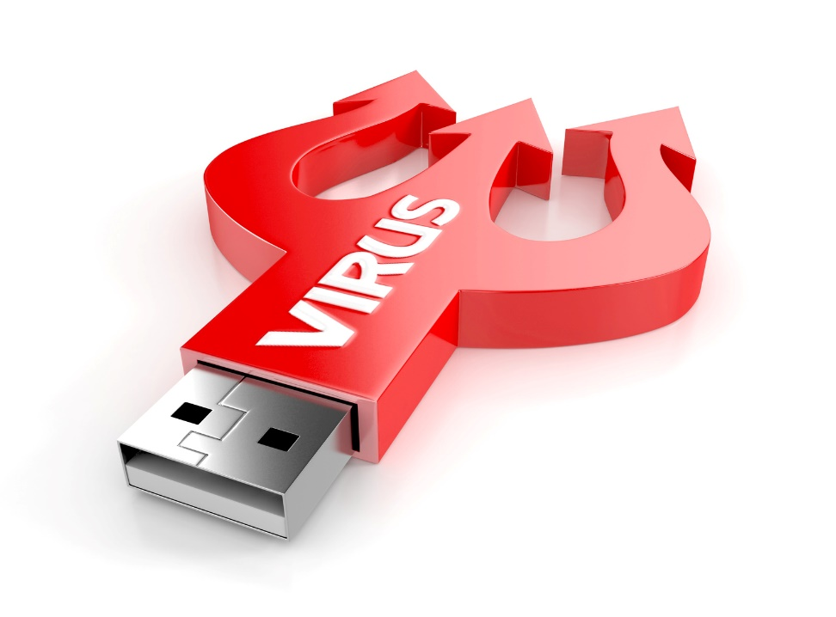
What are the threats?
There are quite a few ways an infected USB key can compromise your safety:
Malicious USB software can allow a hacker to control your device
A third-party can acquire access to your webcam, microphone, or keyboard
Hackers can steal your personal information or erase random data on your device
An infected USB drive can even destroy your hardware
One of the most infamous and dangerous USB drop attacks is called Stuxnet. Once it infected software at industrial sites in Iran, including a uranium-enrichment plant. And well, the Iranese government systems were probably using cybersafety software.
Still, a maliciously dropped USB stick managed to crawl its way into the system.

Slide 5
How does a USB virus attack devices?
There are plenty of ways! Attackers can pretty much use anything USB-related to transfer malicious software to you.
Though, we can name three main types of USB malware attacks:
Malicious code is the most common USB attack. Once a user clicks on a file on a shady USB drive, it launches malicious code to download malware from the internet.
Social engineering. Once a user opens the necessary file on a malicious USB stick, the person is redirected to a phishing site designed to trick them into typing personal information and credentials (email password, credit card details, etc.)
HID or Human Interface Device spoofing. Designed like a USB drive, this hardware tricks users’ computers into thinking it’s a keyboard. Once plugged in, it commands the device to grant remote access to hackers. Crazy, right?

Slide 6
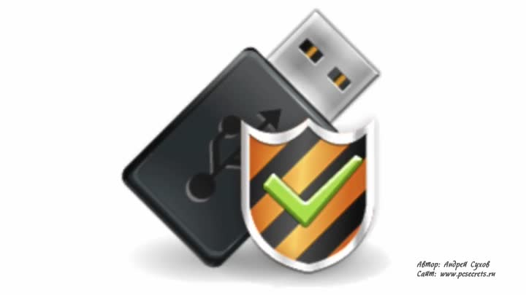
Tips to Keep Your Systems Safe from Infected USB Drives
Do not insert unknown flash drives into sensitive computer systems. This is a social engineering strategy where the attacker takes advantage of people's curiosity.
Use a different flash drive for your home and business PCs. This can help to lessen the danger of your computers becoming infected.

Slide 7
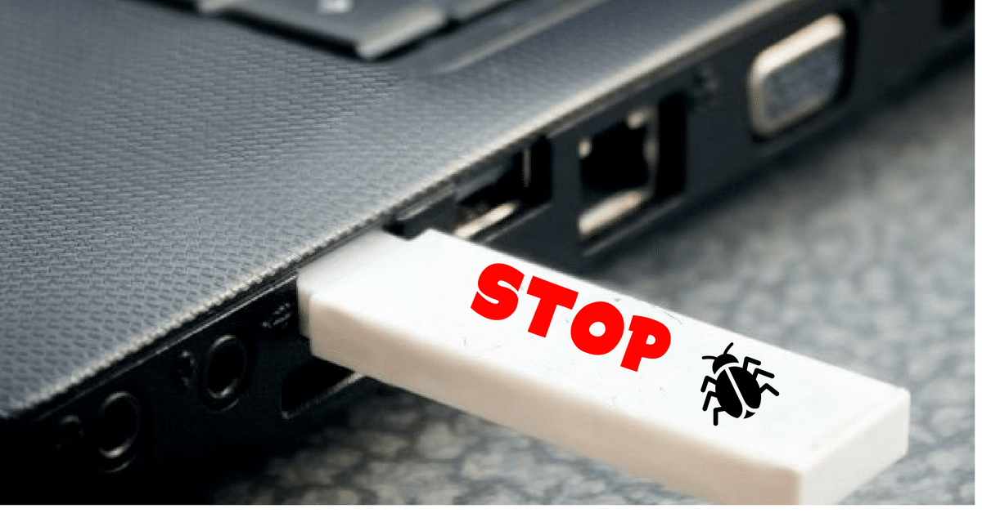
To secure USB drives, always enable security measures such as fingerprint authentication. This will aid in the device's protection against hackers.
Keep your computer's software up to date, as updates provide critical patches for known vulnerabilities.
Disable Autorun - When removable media such as CDs, DVDs, and USB drives are inserted into a drive, Windows' Autorun function forces them to open automatically. You can prevent dangerous malware on an infected USB device from opening automatically by deactivating Autorun.

Slide 8
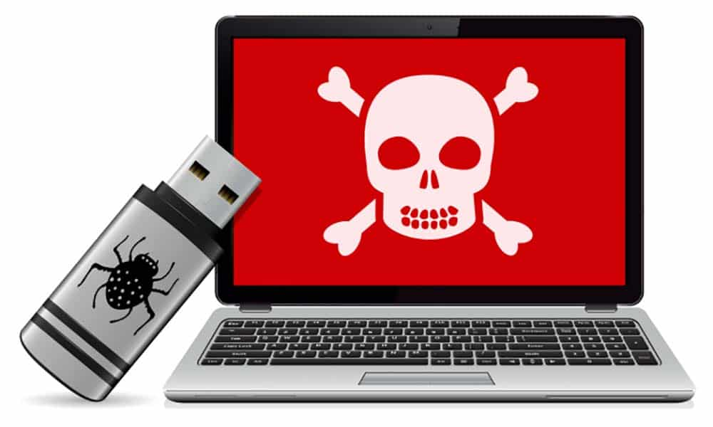
Create and enforce policies about USB drives - Make sure your employees are aware of the dangers of USB drives and what your company's policy is on how to use them properly. Consider including a warning about the risks of USB flash drives in your company's training. No organization is immune to human mistake, no matter how tech-savvy its workers appear to be.
If you have to share a USB drive with a co-worker, create a process for scanning it for viruses and spyware. Many third-party tools and proactive monitoring and management solutions can scan USB devices for safety, but we recommend consulting an IT professional first. Regardless of whether you're giving someone a jump drive to use or getting one, be careful! It's ideal to use the same jump drive from the minute you take it out of the box until you put it out to pasture.

Slide 9
Сonclusion
Keep in mind the potential threats you're exposing your network to the next time you pick up a USB device. Educating yourself and other users about the risks and following computer best practices are the only ways to prevent possible harm. Don't plug your gadgets into computers (or networks) you don't trust and don't plug other people's devices into yours unless you know where they've been.

